Slide 1
JAVA ASSESSMENT
Catarina Vilas Boas

Slide 2
index
Statement
H2 Database
Postman testing
Populated Table
Java Application

Slide 3
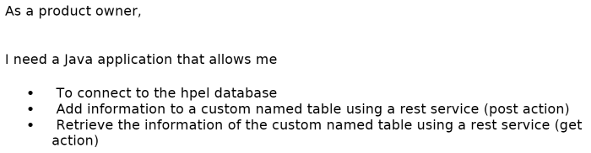
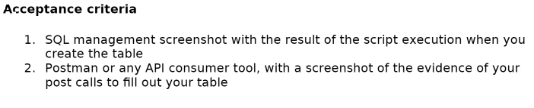
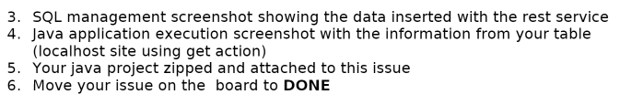
Statement

Slide 4
H2 DATABASE
CONNECTING AND CREATING A SQL TABLE

Slide 5
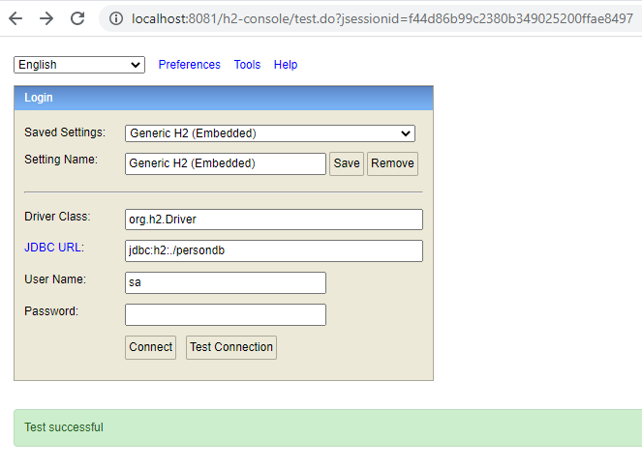
H2 DATABASE CONNECTION & TABLE CREATION
1. ACCESSING H2 DATABASE MANAGEMENT SYSTEM

Slide 6
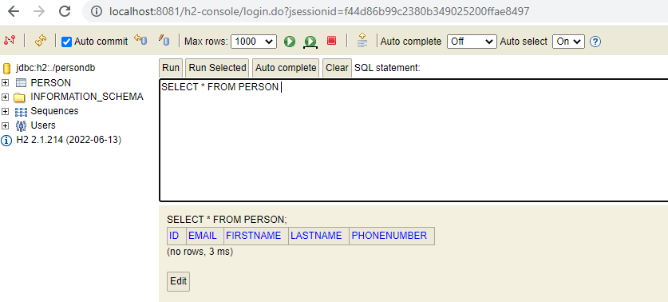
H2 DATABASE CONNECTION & TABLE CREATION
2. TABLE LAYOUT

Slide 7
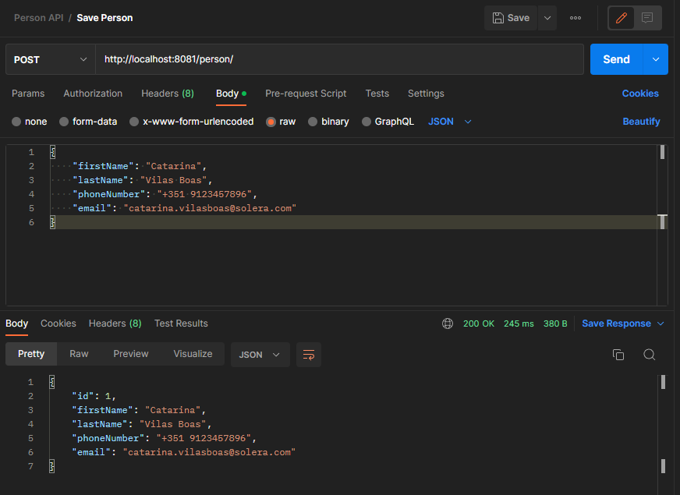
POSTMAN TESTING
EVIDENCE OF POST CALL TO FILL THE TABLE

Slide 8
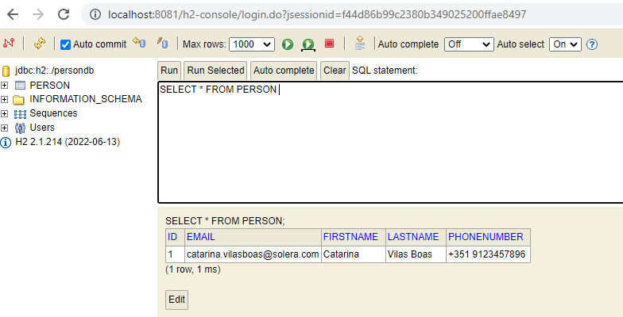
SQL management screenshot showing the data inserted with the rest service
POPULATED TABLE

Slide 9
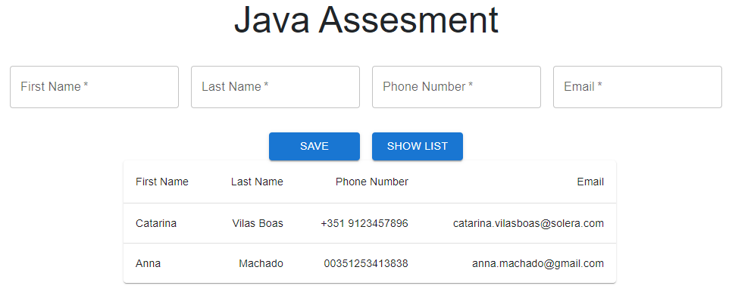
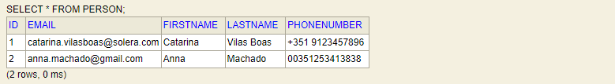
JAVA APPLICATION WITH INFORMATION FROM THE TABLE (CLICK SHOWLIST BUTTON)

Slide 10
THANK YOU
Catarina Vilas Boas
catarina.vilasboas@solera.com

